Slide 1
Computer Graphics III Spherical integrals, Light & Radiometry – Exercises
Jaroslav Křivánek, MFF UK
Jaroslav.Krivanek@mff.cuni.cz

Slide 2
Surface area of a (subset of a) sphere
Calculate the surface area of a unit sphere.
Calculate the surface area of a spherical cap delimited by the angle θ₀ measured from the north pole.
Calculate the surface area of a spherical wedge with angle φ₀.

Slide 3
Solid angle
What is the solid angle under which we observe an (infinite) plane from a point outside of the plane?
Calculate the solid angle under which we observe a sphere with radius R, the center of which is at the distance D from the observer.

Slide 4
Isotropic point light
Q: What is the emitted power (flux) of an isotropic point light source with intensity that is a constant I in all directions?

Slide 5
Isotropic point light
A: Total flux:

Slide 6
Cosine spot light
What is the power (flux) of a point source with radiant intensity given by:

Slide 7
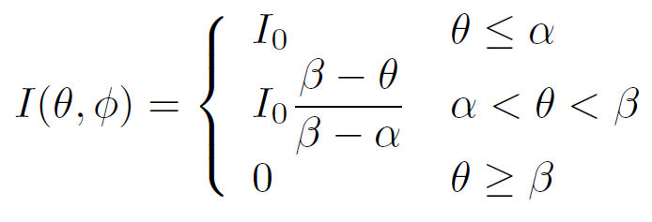
Spotlight with linear angular fall-off
What is the power (flux) of a point light source with radiant intensity given by:

Slide 8
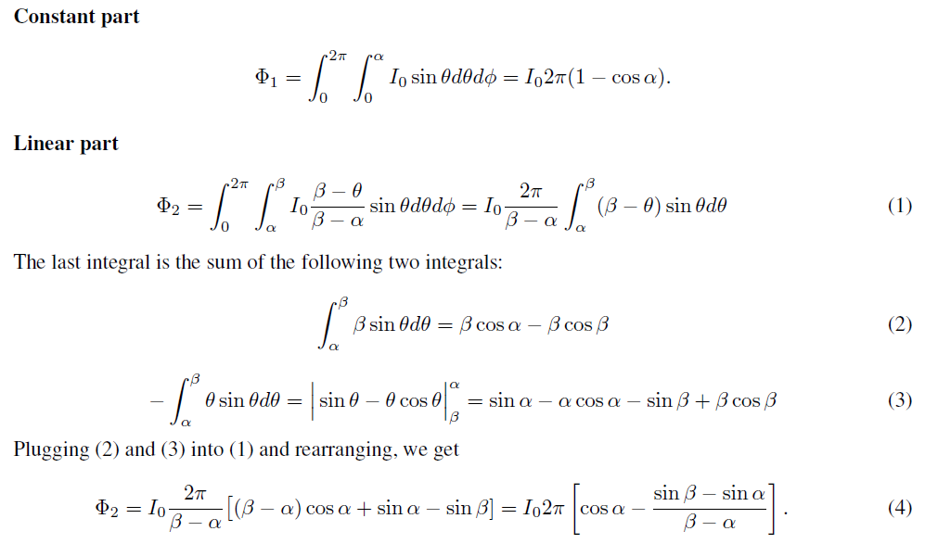
Výpočet

Slide 9
Irradiance due to a Lambertian light source
What is the irradiance E(x) at point x due to a uniform Lambertian area source observed from point x under the solid angle Ω?

Slide 11
Based in these hints, calculate the solid angle under which we observe the Sun. (We assume the Sun is at the zenith.)

Slide 12
Irradiance due to a point source
What is the irradiance at point x on a plane due to a point source with intensity I(ω) placed at the height h above the plane.
The segment connecting point x to the light position p makes the angle θ with the normal of the plane.

Slide 13
Irradiance due to a point source
Irradiance of a point on a plane lit by a point source:

Slide 14
Area light sources
Emission of an area light source is fully described by the emitted radiance L_{e}(x,ω) for all positions on the source x and all directions ω.
The total emitted power (flux) is given by an integral of L_{e}(x,ω) over the surface of the light source and all directions.

Slide 15
Diffuse (Lambertian) light source
What is the relationship between the emitted radiant exitance (radiosity) B_{e}(x) and emitted radiance L_{e}(x, ω) for a Lambertian area light source?
Lambertian source =
emitted radiance does not depend on the direction ω L_{e}(x, ω) = L_{e}(x).

Slide 16
Diffuse (Lambertian) light source
L_{e}(x, ω) is constant in ω
Radiosity: B_{e}(x) = πL_{e}(x)

Slide 17
Uniform Lambertian light source
What is the total emitted power (flux) Φ of a uniform Lambertian area light source which emits radiance L_{e}
Uniform source – radiance does not depend on the position, L_{e}(x, ω) = L_{e} = const.

Slide 18
Uniform Lambertian light source
L_{e}(x, ω) is constant in x and ω
Φ_{e} = A B_{e} = π A L_{e}

